Slide 1
Engineering Project I (Computer Engineering)
2D Platform Game
YOUSEF RAYYAN 1904010031

Slide 2
Information About The Game
What is the aim in the game:
You need to find three keys in the map which will allow you go to the next level and collect the coins in game to get more extra health (and find the way for the next level).
And try to don’t fall or touch the enemies.
Important Things the player must know them :
In game, you have 3 health.
You need to find 3 keys .
You can see all the map by pressing (M).under prosses.
Each 50 coins will give you one extra health.
You have one extra health you need to find it.
Each map(level) have deferent enemies.
There are some pits which you should not fall and there are enemies so If you fall or touched them you will be die and lose your 1 health.
Now The game can be played with full screen you can press (F) and for the normal screen you can press(ESC).

Slide 3
What development tools and software languages ​​was used for the project?
Python 3.8 programming language.
Python is an outstanding language for people learning to program.
PyCharm Compiler.
PyCharm is an integrated development environment (IDE) used in computer programming, specifically for the Python language.

Slide 4
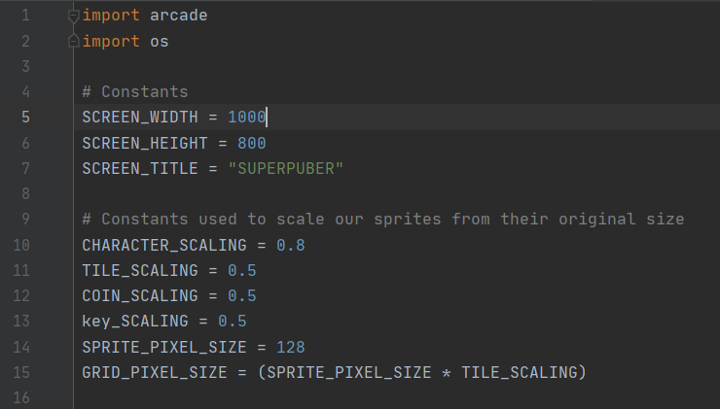
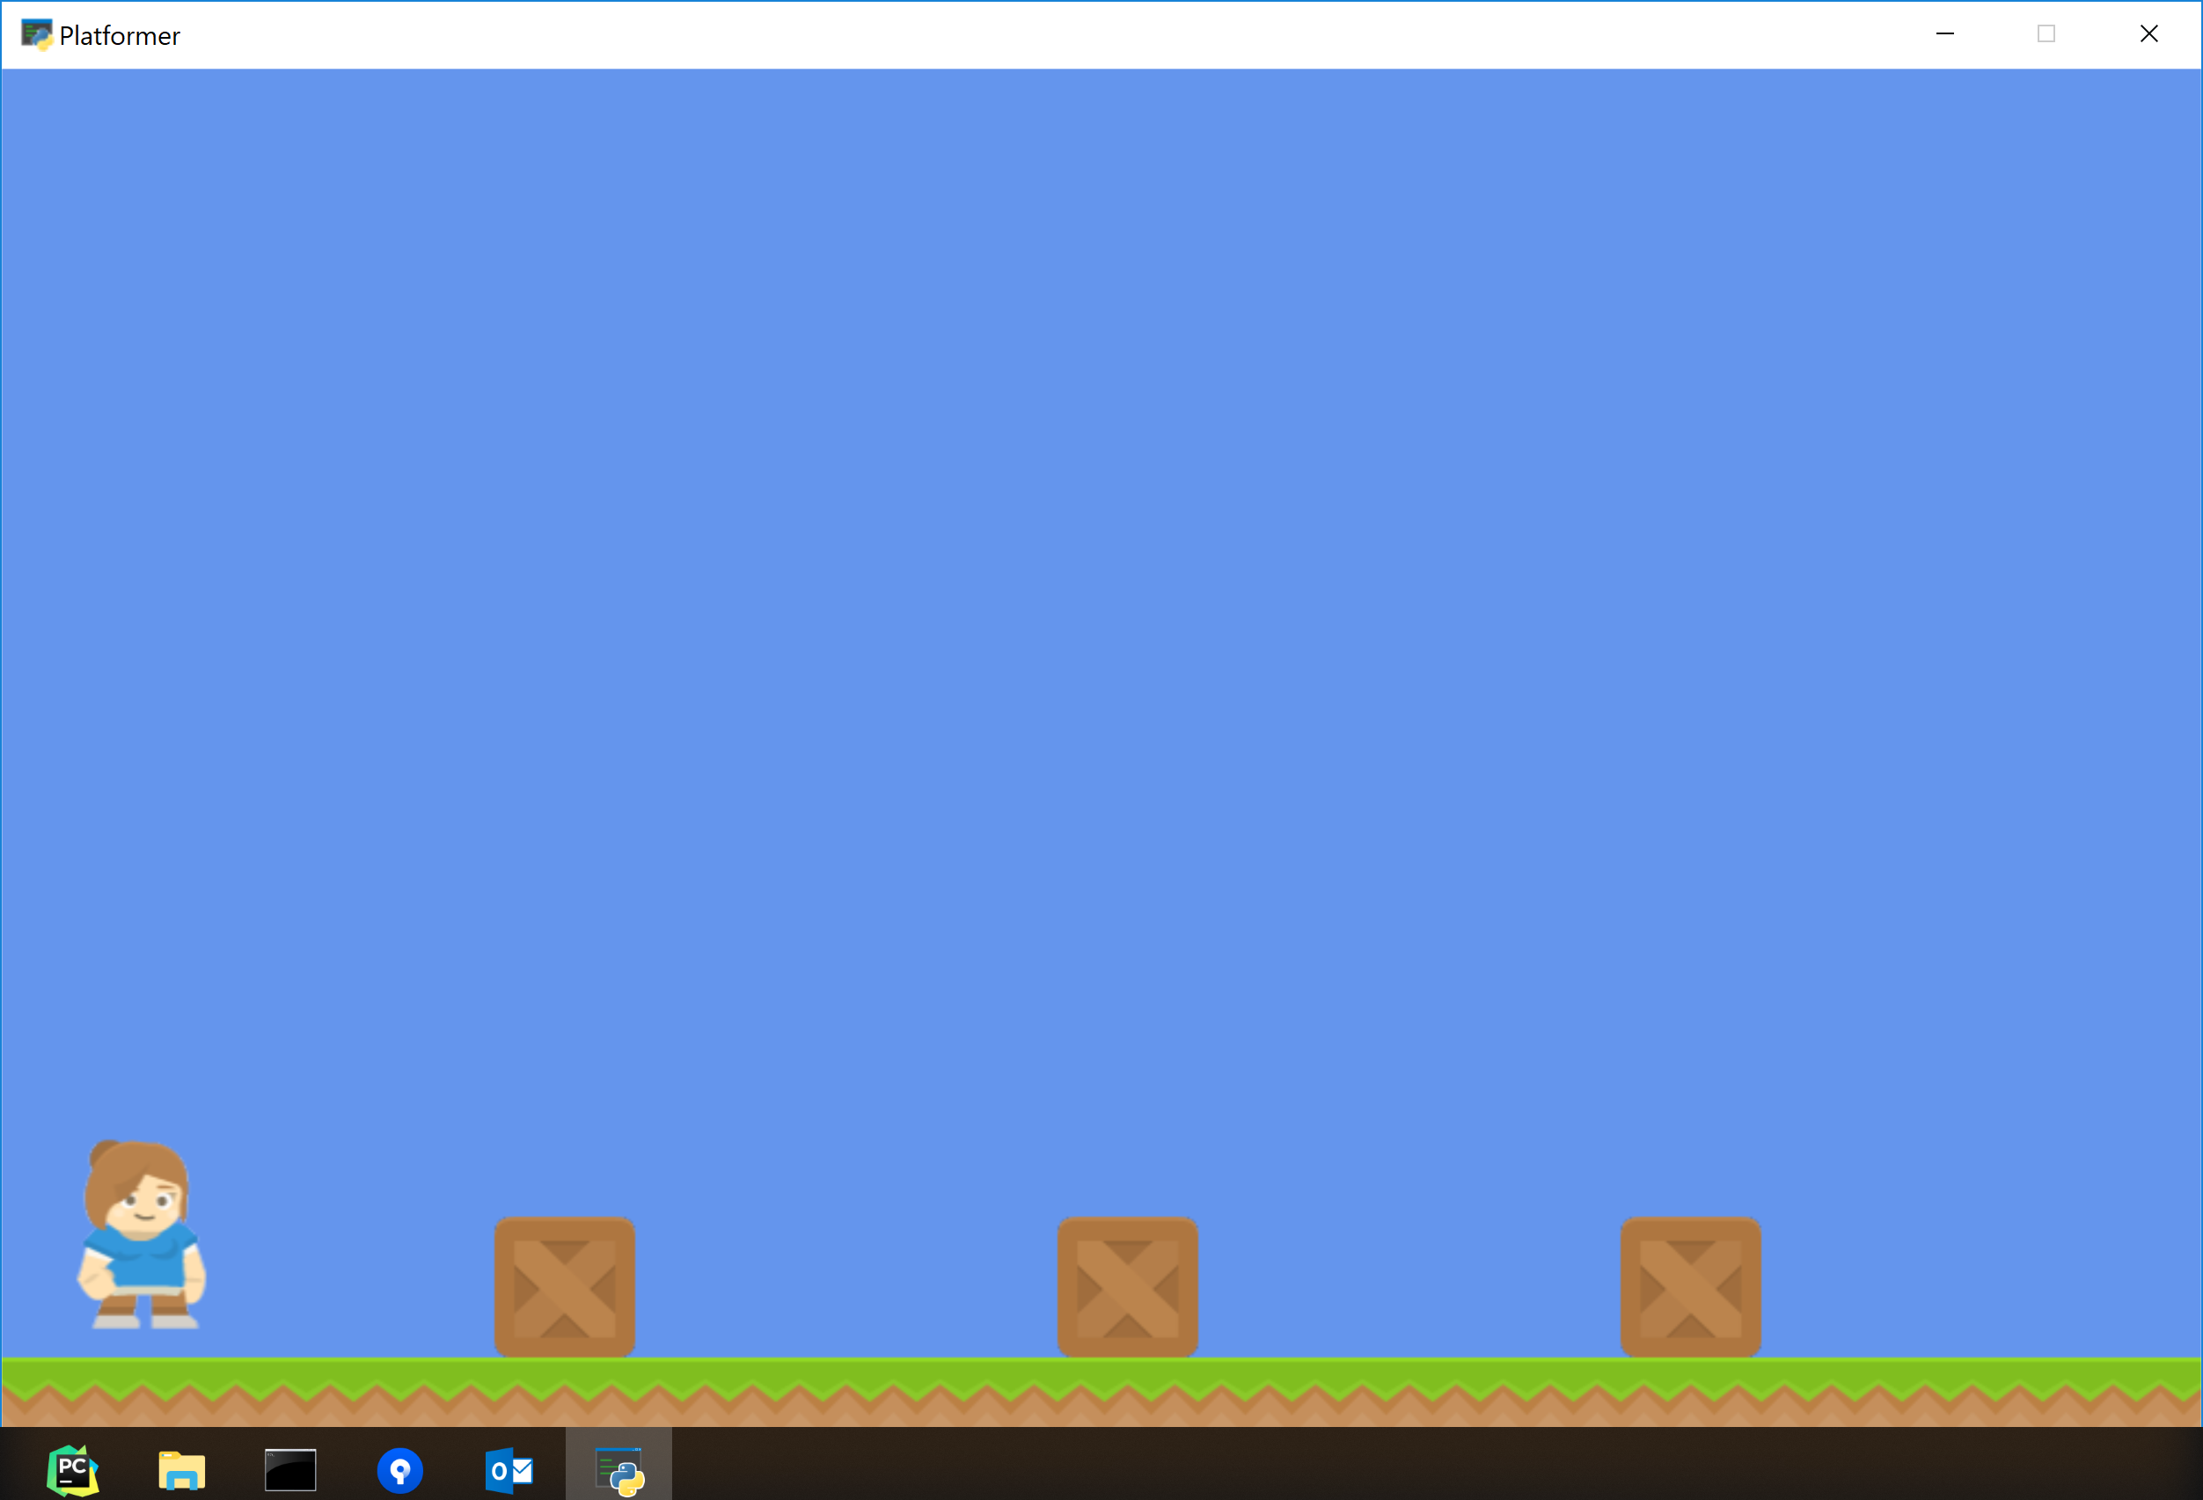
The STEPS AND ACHIEVEMENTS
1. Opening a game window.
In order to open a game window, you must’ve downloaded arcade library beforehand.
2.Sprite addition
After opening a new game window, the next step is to put in some graphics. “Sprites” are the graphical items that you can interact with. I create a sprite by using “Sprite” class.

Slide 5
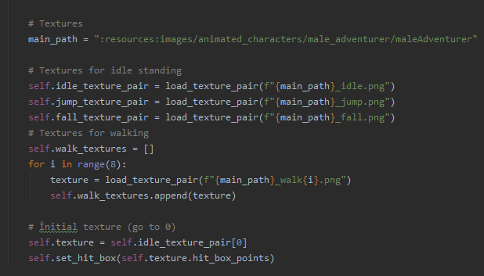

Character definition
By writing this code, I’m defining my player’s character.

Slide 6
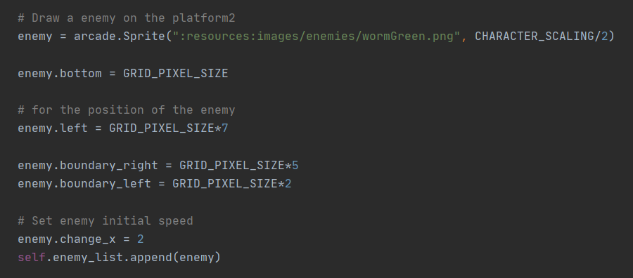


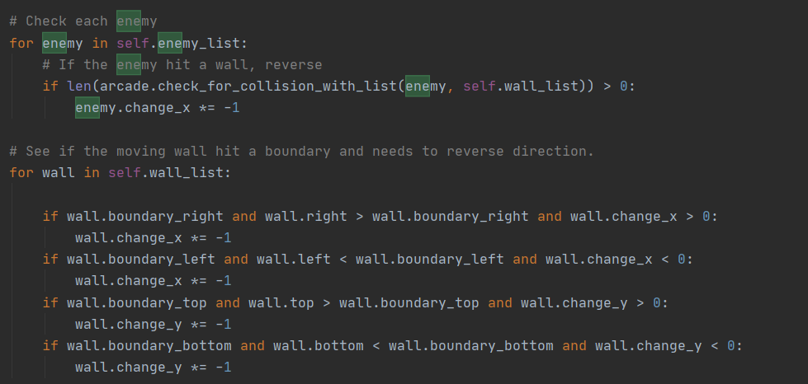
enemies definition
By writing this code,
I’m defining my enemies character.

Slide 7
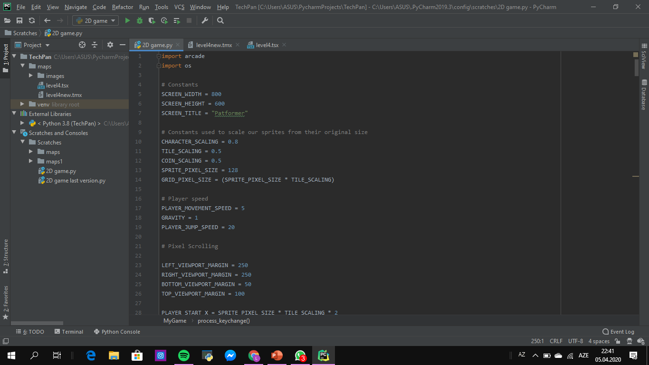
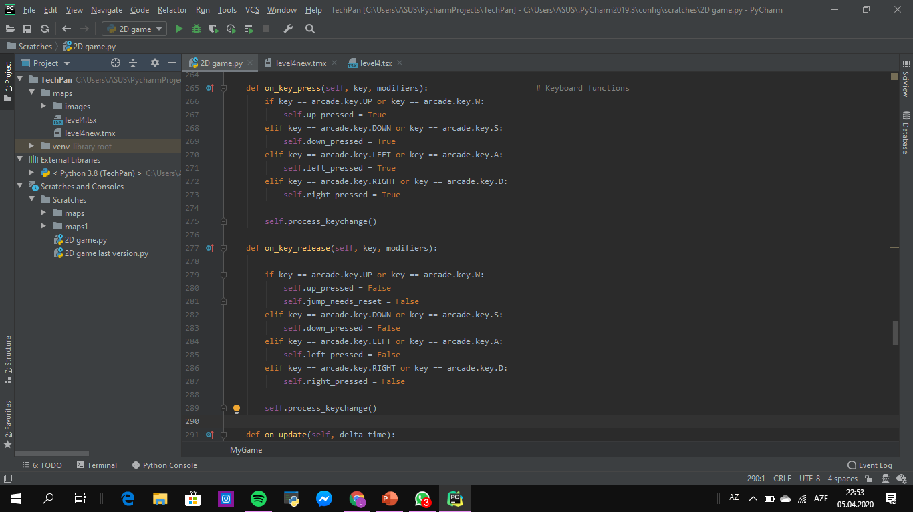
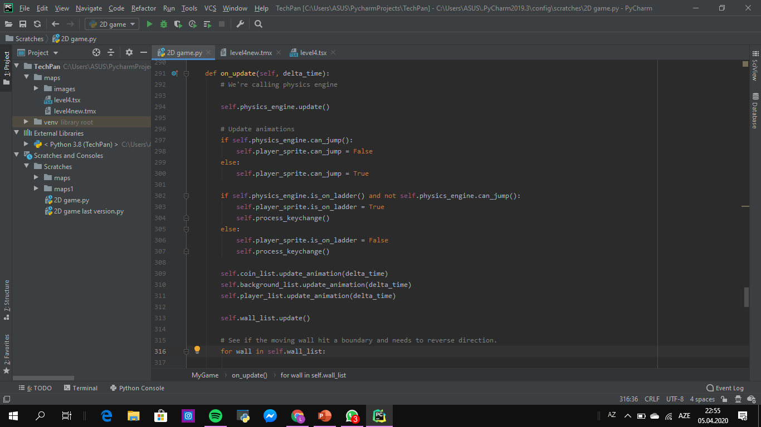
Adding the user control.

Slide 8
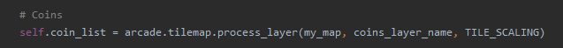
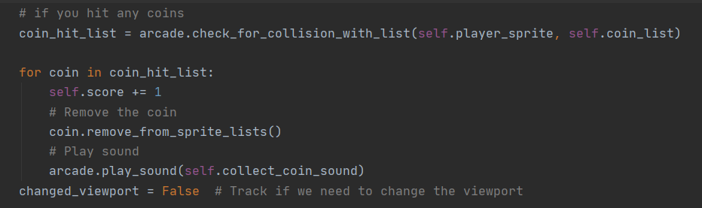

Adding coins and sound
The codes in here adds coins that the player can collect. When player hits any coins, or presses jump button it also adds sound.

Slide 9
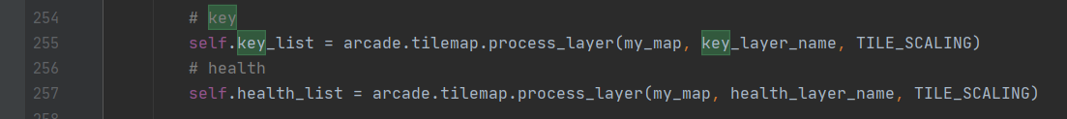
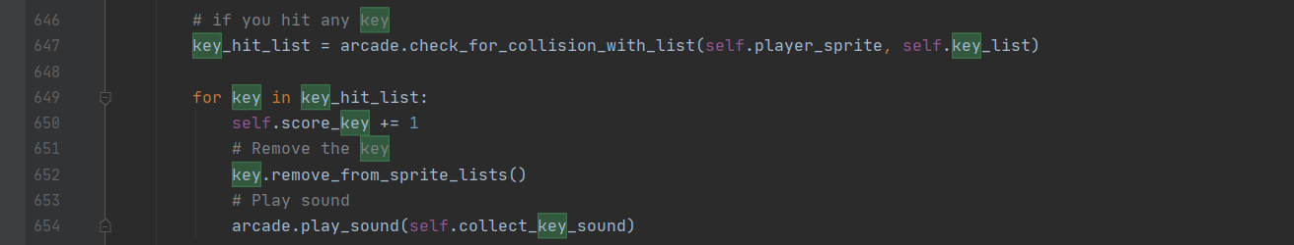

Adding keys and sound
The codes in here adds key that the player can collect. When player hits any key,
there’s a sound for it.

Slide 10
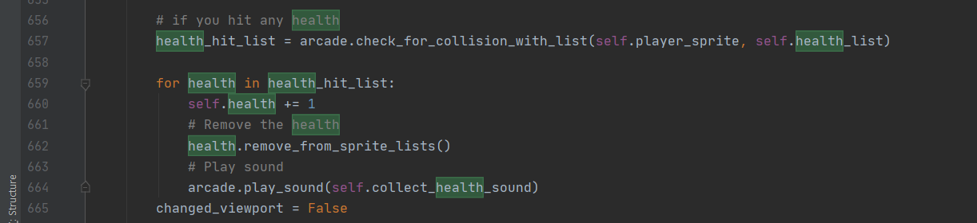

Adding health and sound
The codes in here adds health that the player can collect. When player hits any health, there’s a sound for it.

Slide 11
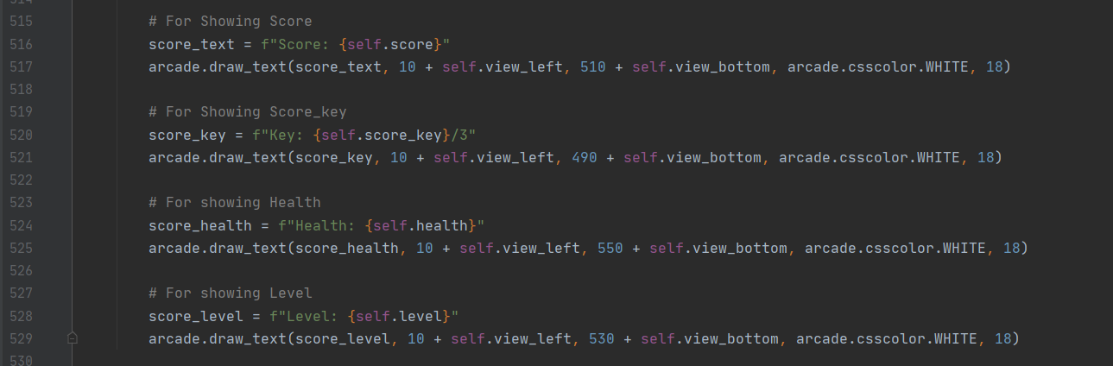
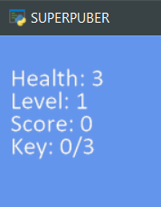
Displaying the score, Health, Level and keys.

Slide 12
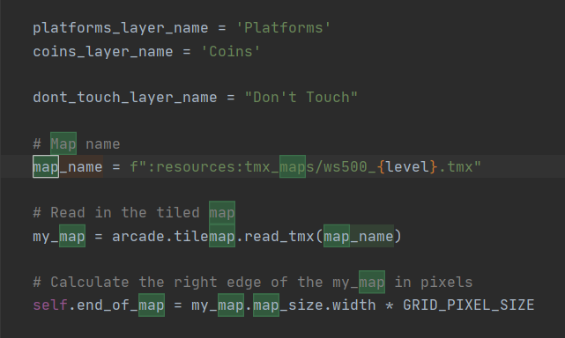
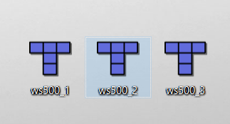
Map addition
In here, I’m adding the maps that I’ve created into my code. by coding TMX & TSX files here.

Slide 13
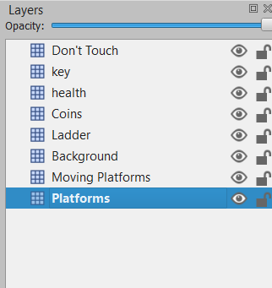






Layers in TMX map.
This one for the lava.
This one for the keys.
This one for the health.
This one for the coins.
This one for the ladders.
This one for background items.
This one still under proses.
This one for the ground and blocks.

Slide 14
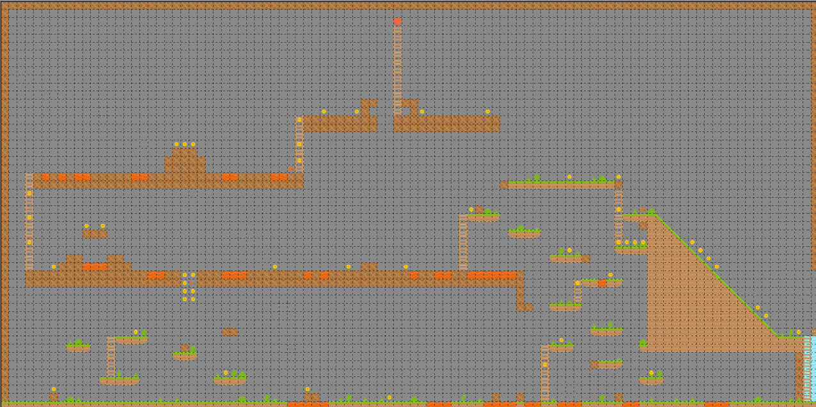
And this is the map that I used for my 1 level. I’ve created it by using “Tiled” map editor.
The key 3
The health
The key 2
End point
The key 1
Start point

Slide 15
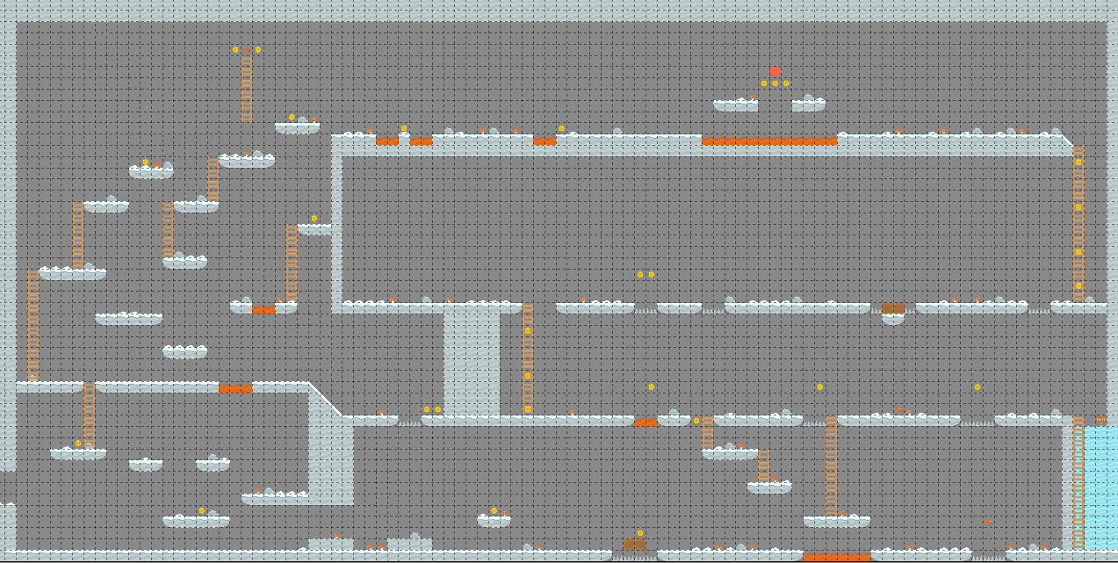
And this is the map that I used for my 2 level. I’ve created it by using “Tiled” map editor.
The key 1
The health
The key 3
End point
The key 2
Start point

Slide 16
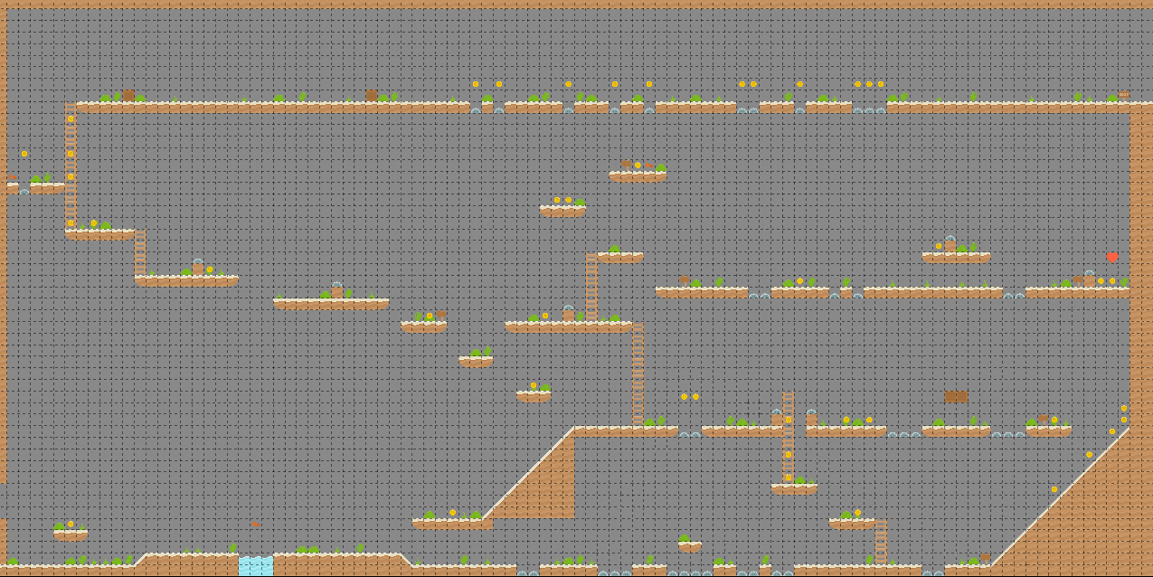
And this is the map that I used for my 3 level. I’ve created it by using “Tiled” map editor.
The key 3
End point
The key 2
The health
The key 1
Start point

Slide 17
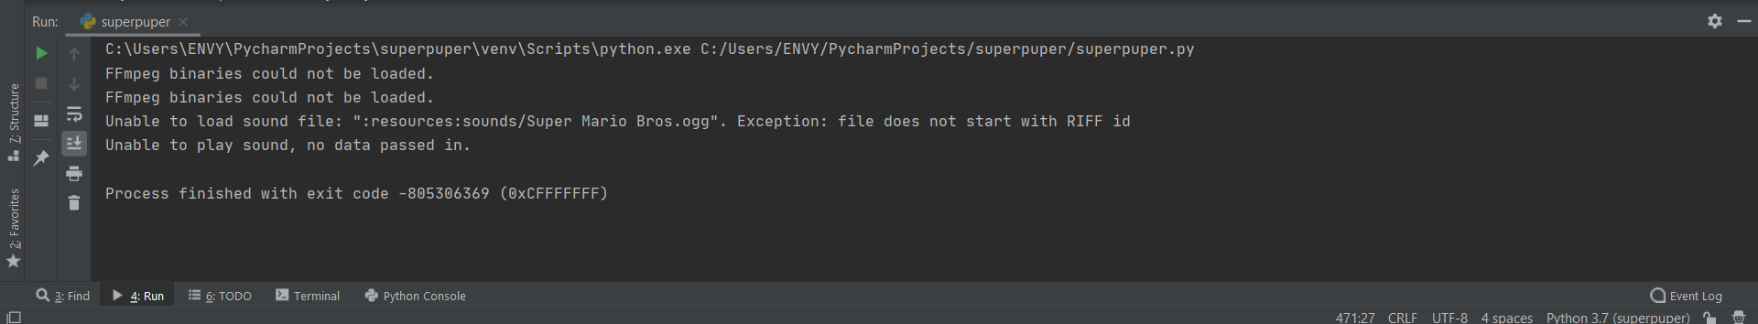
The game have one ERROR
Sometime the game give me this return value , and I can’t find any solution for this situation

Slide 18
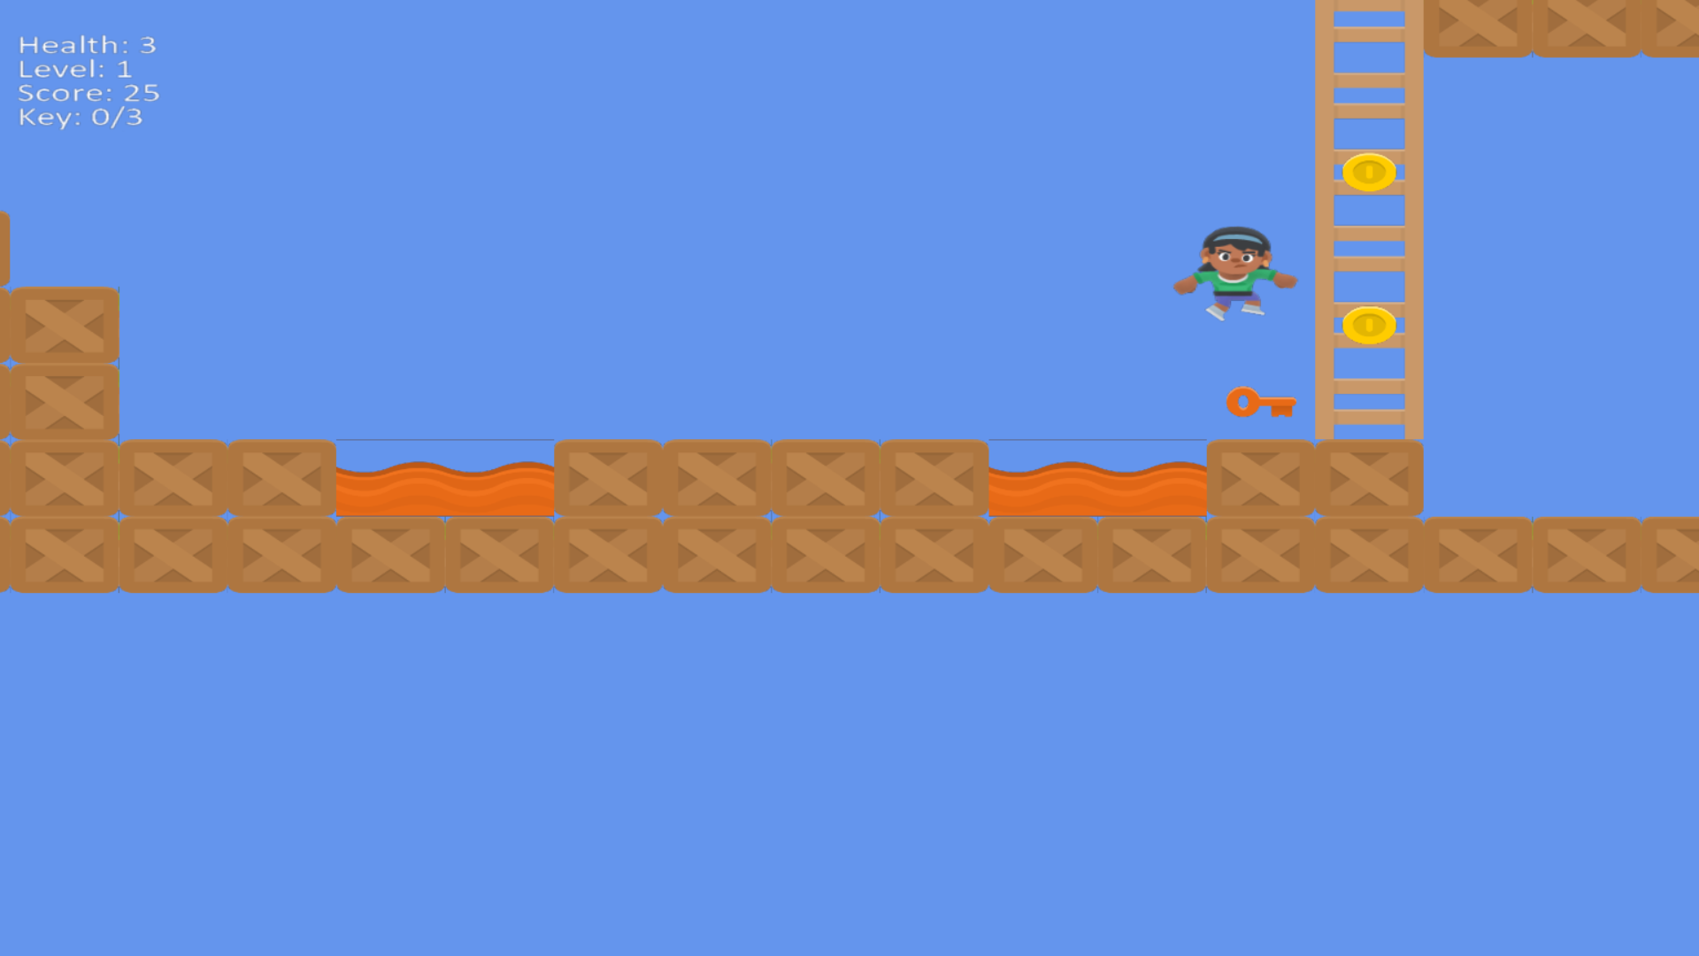
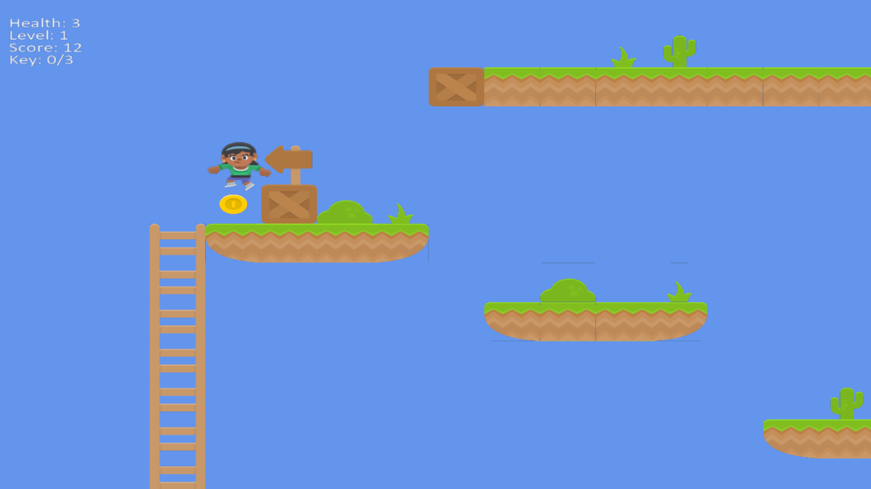
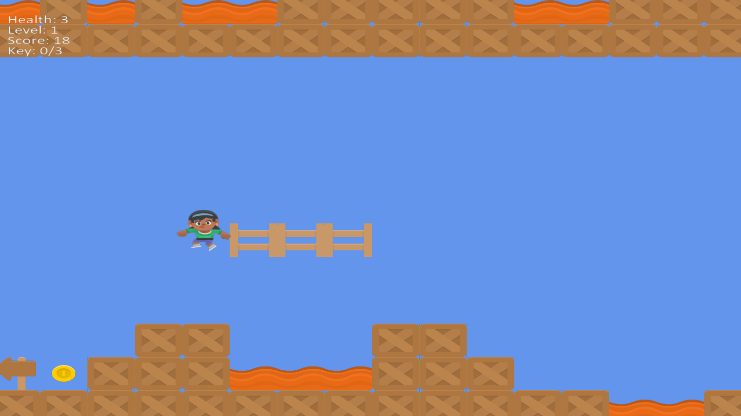
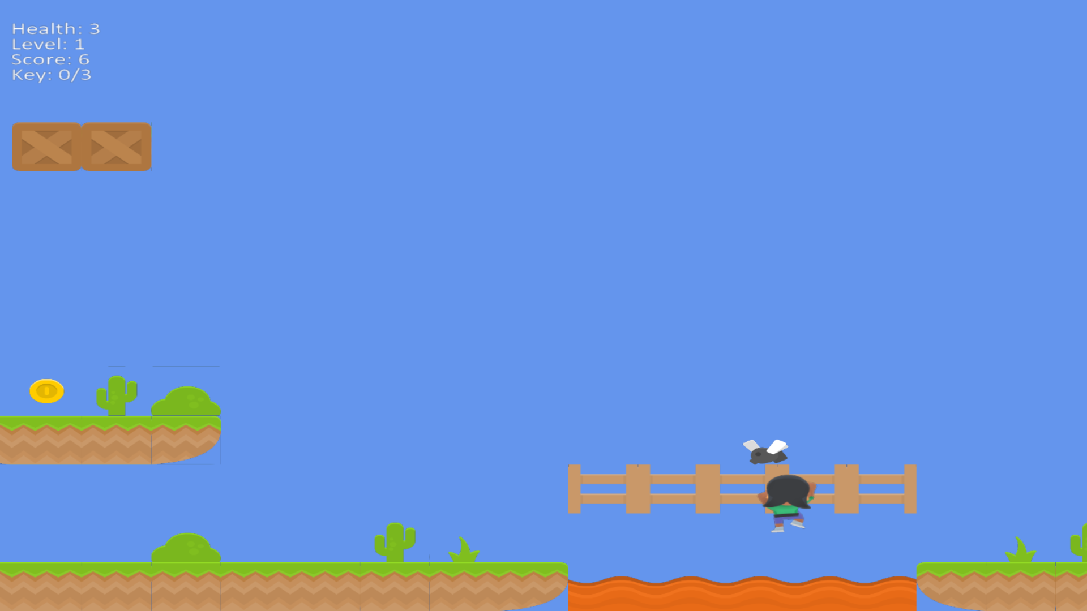
As you can see, this is the final model of THE “SUPPERPOPER”. For the first Level

Slide 19
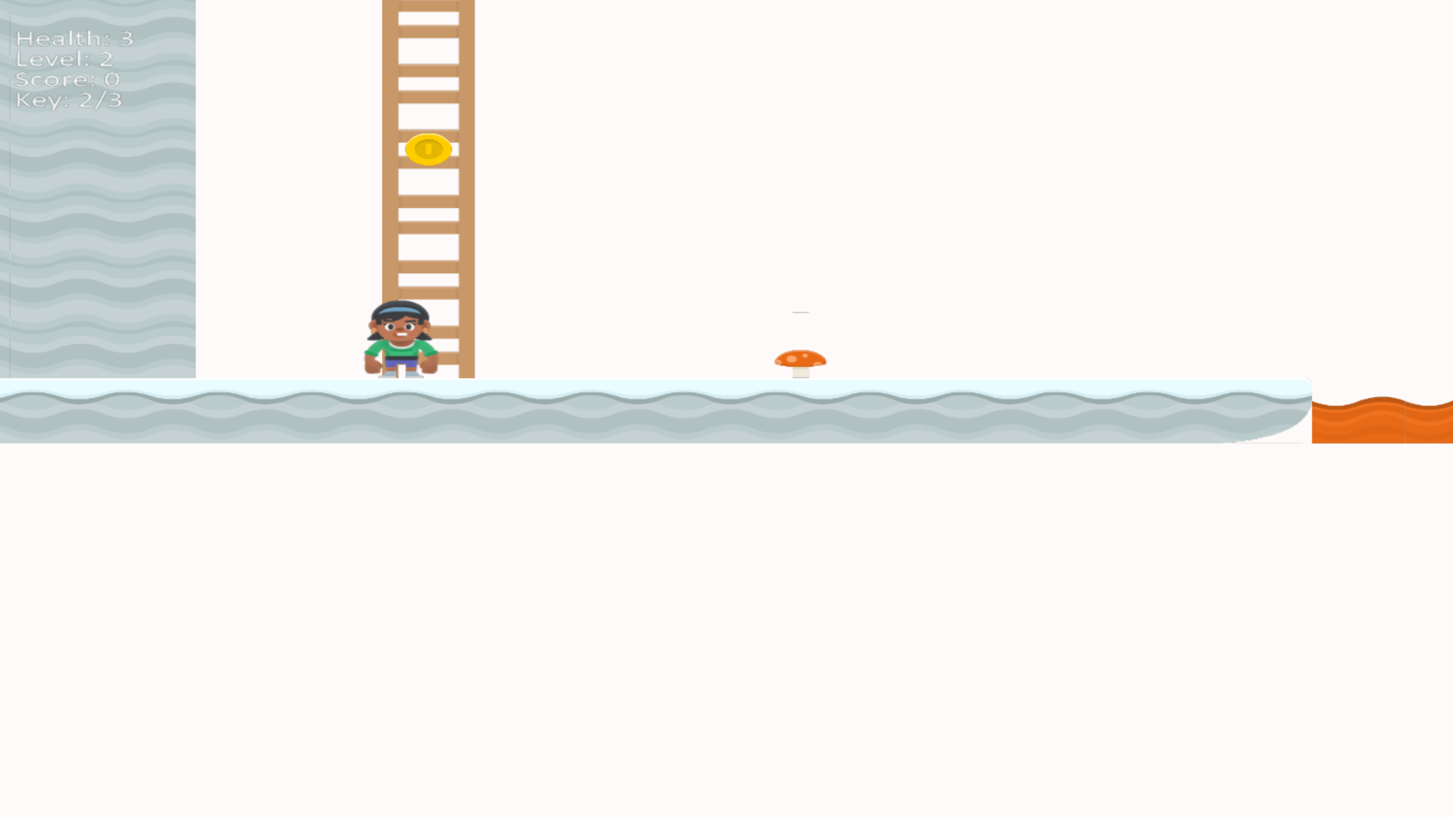
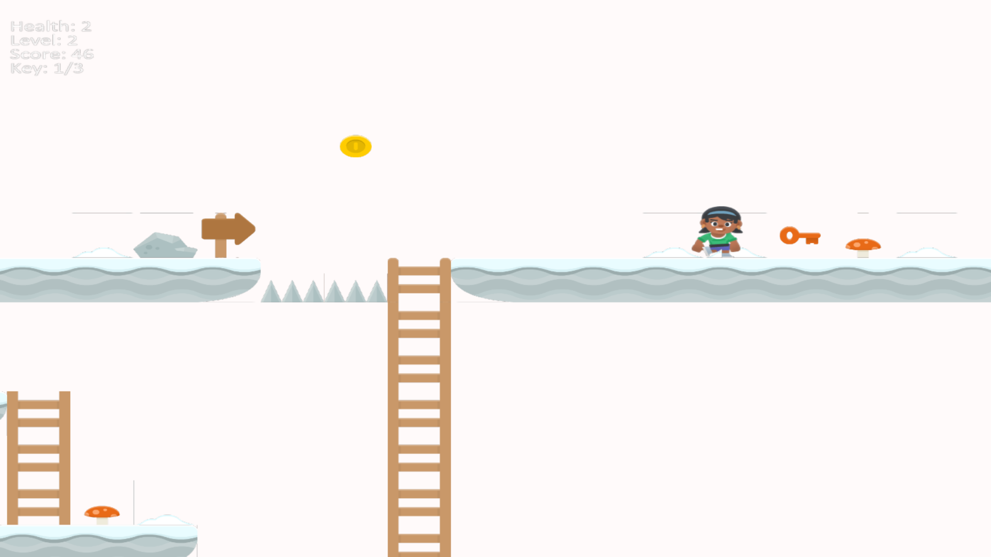
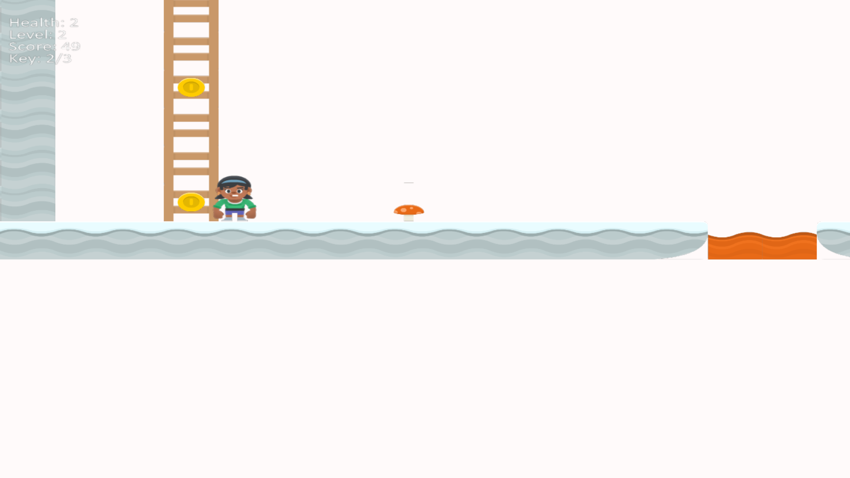
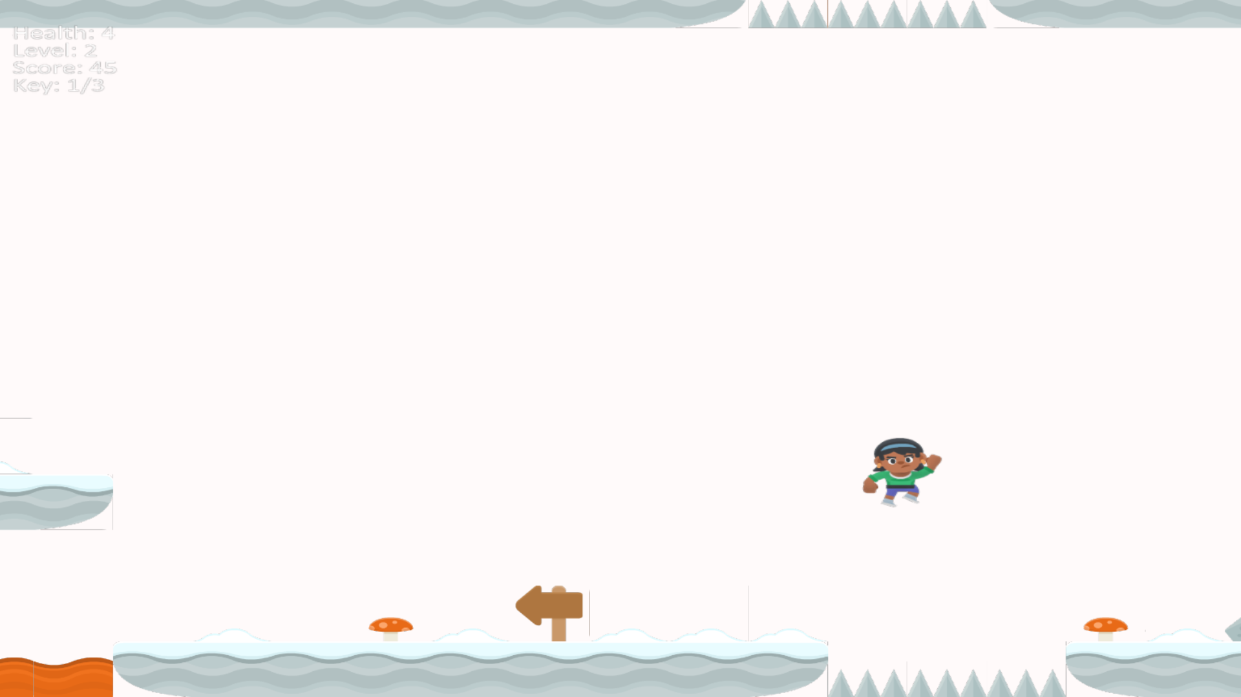
As you can see, this is the final model of THE “SUPPERPOPER”. For the second Level

Slide 20
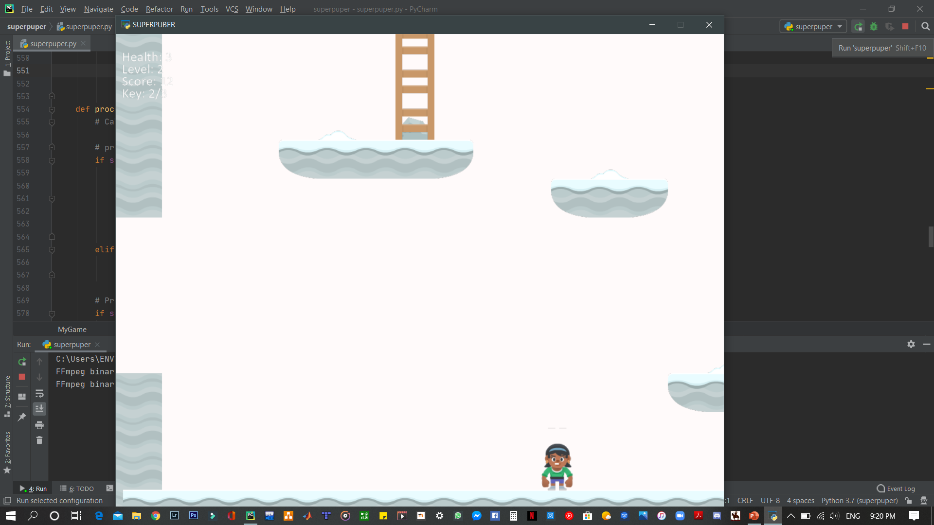
The full screen and the normal screen

Slide 21
